Slide 1
Basic Arithmetic

Slide 2
Math!
*, +, -, /, %
* Multiplication, 4 * 3
+ Addition, 4 + 3
- Subtraction, 4 – 3
/ Division, 4 / 3
% Modulus (remainder), 4 % 3
Notes:
There is an example of modulus on the next slide

Slide 3
Modulus (remainder) example
4 % 3
4 / 3 remainder
4 / 3 = 3, remainder 1
4 % 3 = 1
12 % 4
12 / 4 remainder
12 / 4 = 3, remainder 0
12 % 4 = 0

Slide 4
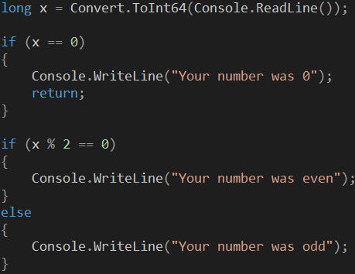
Example

Slide 5
Spec Ops – Just like Navy SEALS
++, --
Increment and Decrement
x++; is the same as x = x + 1;
+=, -=, *=, /=, %=
Operate and Assign
x *= 2; is the same as x = x * 2;

